Slide 1
Alligator clips
Usually:
Red is “positive” or signal
Black is “negative” or ground
BNC Connectors
Test clips
BNC “Tee”
Used to “split” a signal
Often: one side to a
“transducer” and one
side to a oscilloscope
Ultrasonic “Transducer”
Convert electrical signals
to/from “ultrasound” (which
is just sound but at a frequency
that you can’t hear!)

Slide 2
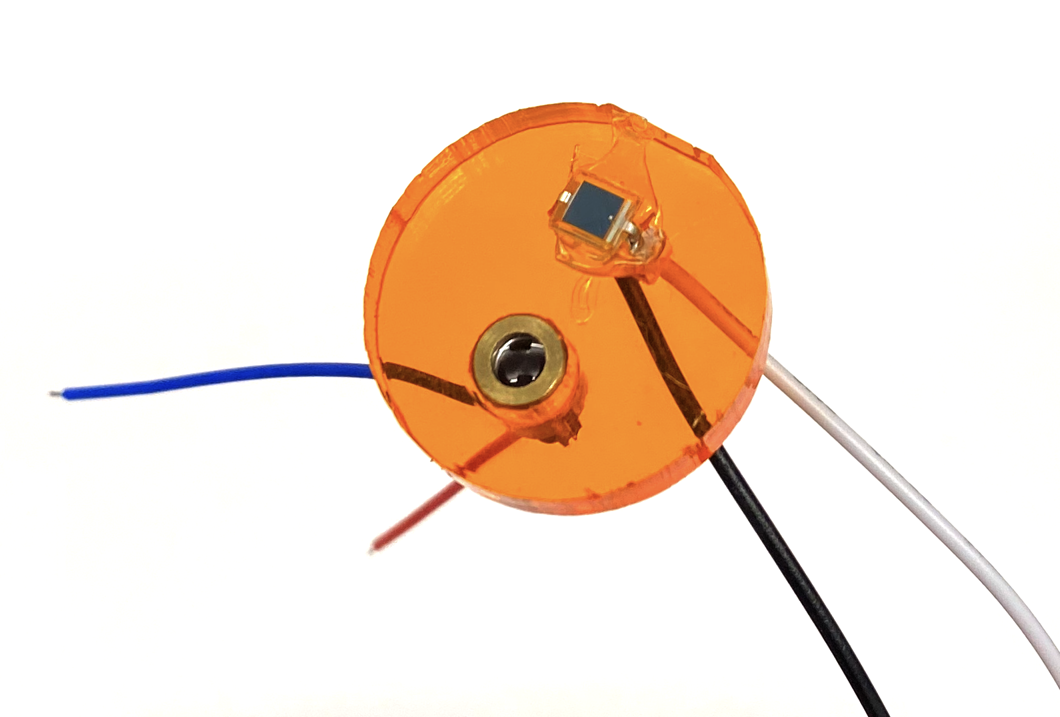
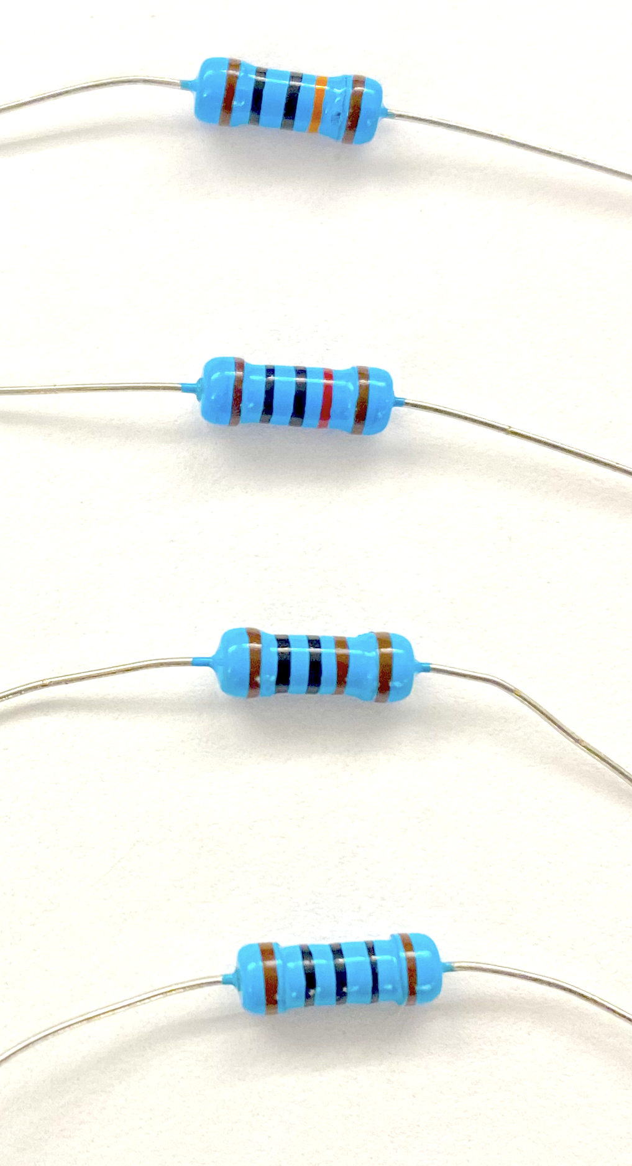
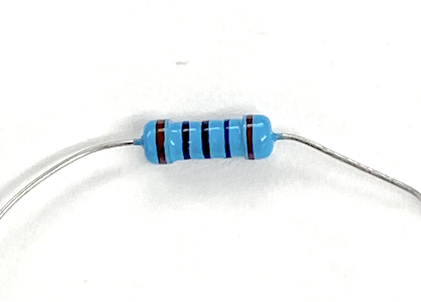
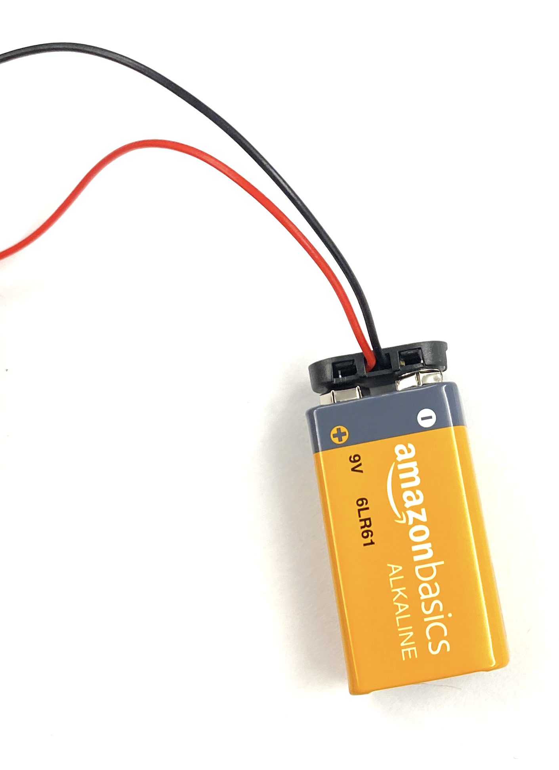
Top: Laser
Input 5 V max from function generator (red → red)
100 kΩ (Stripe 4: orange)
Photodiode Circuit:
Measure voltage across resistor w/ oscilloscope
10 kΩ (Stripe 4: red)
1 kΩ (Stripe 4: brown)
100 Ω (Stripe 4: black)

